Slide 1
Shark Tank, OKTA Tank Singapore Ver.

Slide 2
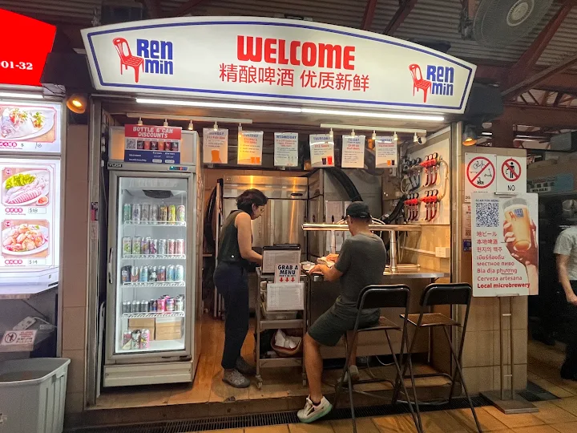
Maxwell Hawker Centre – Ren Min Beer

Slide 3
탄파 오빠짜장
77A Tg Pagar Rd, Singapore 088498
Usable area : 970sqft
22,000/month

Slide 4
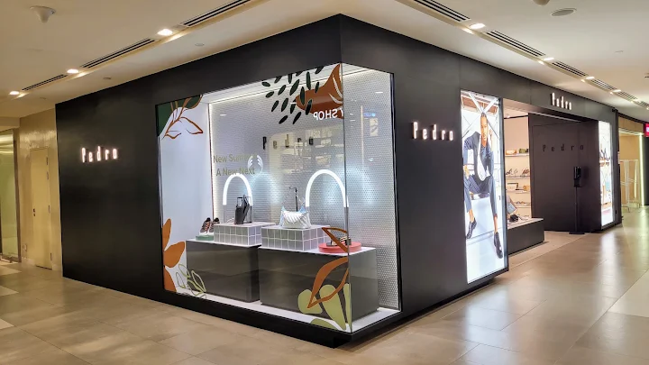
Plaza Singapura - PEDRO
68 Orchard Rd, #01-03 Plaza Singapura, Singapore 238839
Usable Area : 834 sqft
35,000/month

Slide 5
KOTRA
#13-02 Suntec Tower One, 7 Temasek Blvd, 038987
2,000sqft
50,000/month

Slide 6
Location 1) Hawker Centre – Maxwell Food Centre
Location 2) Commercial - Tanjong Pagar Road Restaurant (Oppa Jjajang)
Location 3) Shopping Mall – Plaza Singapura
Location 4) Business District – Kotra

